Slide 1

A Unique Vision

Slide 2
Agenda
What is IIF?
What has IIF done so far?
What does IIF plan to do?

Slide 3
Agenda
What is IIF?
What has IIF done so far?
What does IIF plan to do?

Slide 4
India Insulation Forum (IIF)
The Vision:
People Everywhere Use the Power of Insulation
BEE and the insulation industry leaders have collaborated together for the establishment of "India Insulation Forum (IIF)“ in 2013.
IIF also coordinate advocacy activities with Government bodies & nodal agencies.
IIF is represented by reputed companies making modern insulation materials used for energy efficiency in Buildings.
The IIF membership is open to all concerned with building insulation, beginning with raw material suppliers, applicators, builders & contractors, architects, regulators & consumers.
The objective of IIF is to enhance awareness of using thermal insulation in building envelope and cold chain industry for energy conservation.

Slide 5

Heat Load Components:
Warm-Humid Climate (Chennai)
Summer: Heat in-flow (May)
Weather Conditions
Temperature | Min.: 22.5ºC, Max.: 39.5ºC, Avg.: ~31.5ºC
Relative Humidity | Min.: 33%, Max.: 98%, Avg.: ~69%
Roof: 25%
Wall: 32%
Windows: 36%
Net heat flow per unit area
Roof (15 m²) | 17.0 kWh/m²
Wall (47.6 m²) | 7.3 kWh/m²
Window (8.4 m²) | 44.5 kWh/m²
Infiltration (based on floor area 15 m²) | 4.9 kWh/m2
Infiltration: 7%
Source : BEEP

Slide 6
Why Insulation? Energy > Money
An example in a Composite Climate (New Delhi)
Summer: Heat in-flow (May)
Business-as-usual construction
Roof U-value: 4.2 W/m².K
Wall U-value: 2.1 W/m².K
ECBC compliant roof & wall
Roof U-value: 0.261 W/m².K
Wall U-value: 0.44 W/m².K
Roof: 24.6 kWh/m²
Roof: 2.1 kWh/m²
Wall: 2.3 kWh/m²
Wall: 8.1 kWh/m²
Reduction in heat in-flow through roof ∼ 90%
Reduction in heat in-flow through walls ∼ 70%
Source: BEEP analysis
Notes:
Note: Windows include both direct solar heat gain as well as the heat gain through conduction

Slide 7
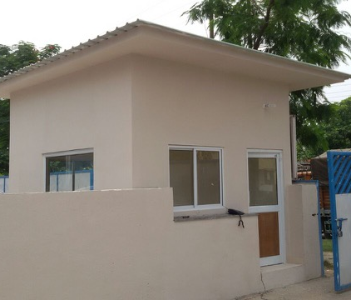
Your partner to increase your value
Stakeholder Awareness
Training of Applicators
Testing of Insulation Materials.

Slide 8
Impact of Roof & Wall Insulation
Typical summer day in Composite climate (Delhi)
With a 50mm Envelop insulation.
Maximum Temperature Difference is 13.9°C @ 14:hrs
Source : Owens Corning
Notes:
Single zone: 3m x 5m
External wall: 9 inch brick
Roof: 6 inch RCC slab
Window to wall ratio: 15% (all sides)
No heat exchange with the ground (adiabatic)
No internal loads
Cooling set-point: 24ºC
Heating set-point: 22ºC

Slide 9
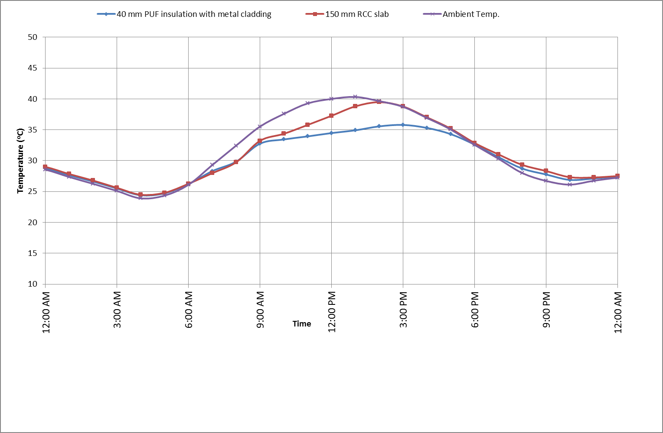
Impact of Roof Insulation
School building in a typical summer day in Composite climate (Indore, M.P.)
With a roof of 40mm insulation with metal cladding
  Up to 6-7ºC cooler than ambient
  Up to 4-5ºC cooler than RCC
Source : BEEP
Notes:
Single zone: 3m x 5m
External wall: 9 inch brick
Roof: 6 inch RCC slab
Window to wall ratio: 15% (all sides)
No heat exchange with the ground (adiabatic)
No internal loads
Cooling set-point: 24ºC
Heating set-point: 22ºC

Slide 10
Insulation Benefits
Environmental
Stop heat / cold ingress from outside
Saves on fossil fuel
Lower energy losses; avoid the danger of oversized heating or cooling systems that works hard to compensate for the heat or cold losses through the building envelope.
Economical
Effective insulation lowers heating or cooling bills, thus no longer being affected by rising energy costs
Maintains controlled temp. for longer periods.
Social
Human Comfort – improves the efficiency of occupier/user.
Provides fungus-free and microbe-free healthier environ, due to absence of cold walls
Reduces emission of GHG.

Slide 11
Agenda
What is IIF?
What has IIF done so far?
What does IIF plan to do?

Slide 12


















Members - glocal

Slide 13
IIF Organization
Committee
Delhi Chapter
Mumbai Chapter
Chennai Chapter

Slide 14
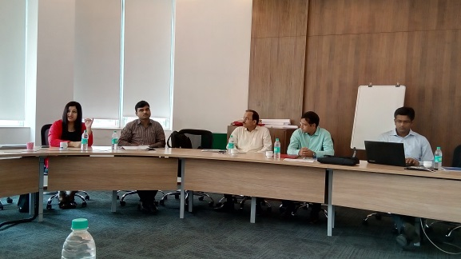
…..2015
Membership (Bayer MaterialScience, Isofoam)
Clear Benefit Statement
Opening of Western Region Chapter
Pending Creation of Advisory Board
Opening of Southern Region Chapter
Nationwide seminars/webinars every quarter (Lloyd Insulations, IPUA)
Alignment with IIA
MOU with IGBC
Utilization of BEE SDA
Resource mine
Online Help tools, advisory, calculator
Awareness
Insulation Materials Testing Facilitation Program (Lloyd Insulations, Supreme Petrochem)
Any NABL-approved lab tie up
Time –bound discounts
Program for Applicator Capacity Building (Lloyd Ins, Owens Corning)
Partnership with ITI; to seek inclusion in the curriculum
Certified courses (from BEE, ISOPA)
Quarterly – 1st completed in GB Pant Polytechnic
Website of tools and case studies (Owens Corning, Bayer MaterialScience)
Bayer MaterialScience is now called Covestro

Slide 15

Applicator Orientation
Applicator Training Manual - a comprehensive document targeting the weakest link in the value chain. TRAINING MANUAL
First of its kind in India
Scope on ECBC context
Aimed at enhancing the appreciation of building energy efficiency through technical insulation

Slide 16
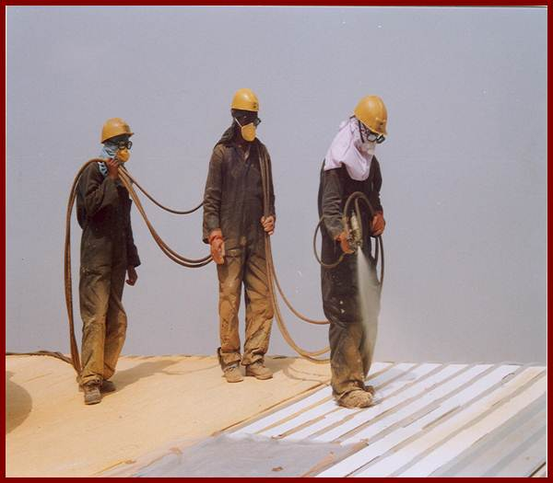
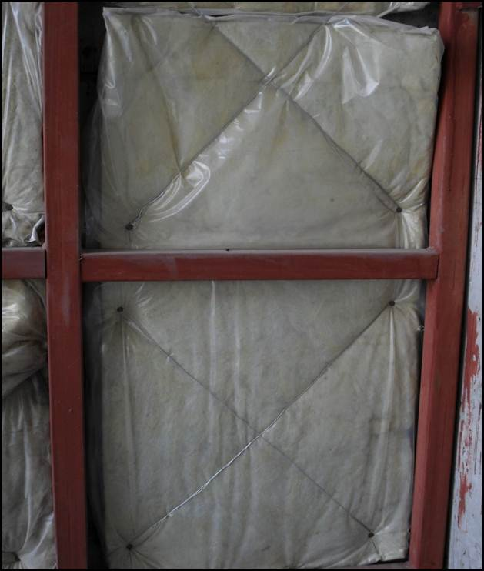
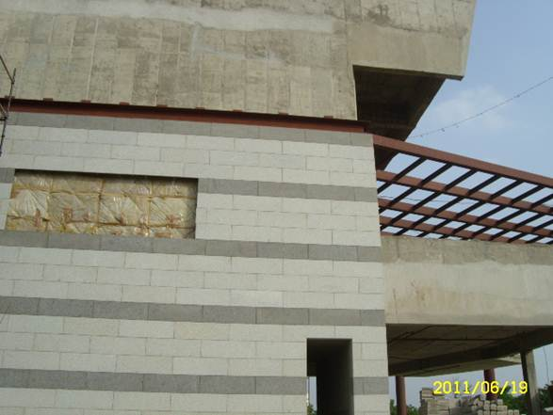
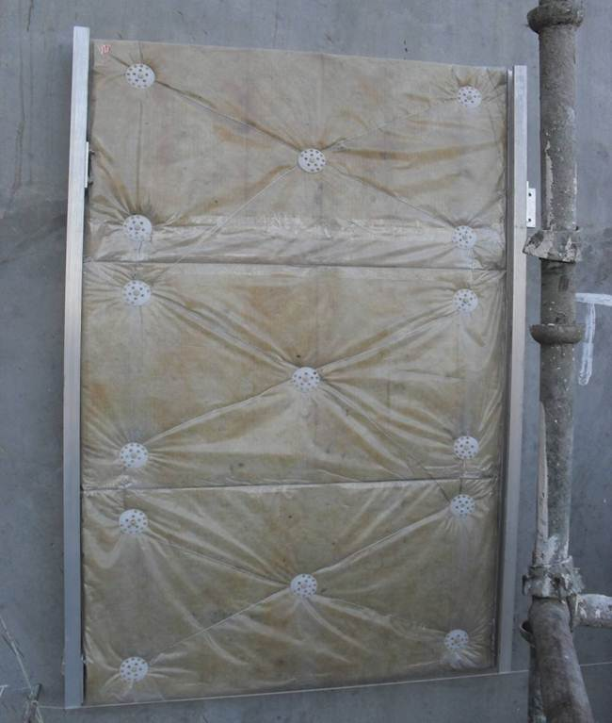
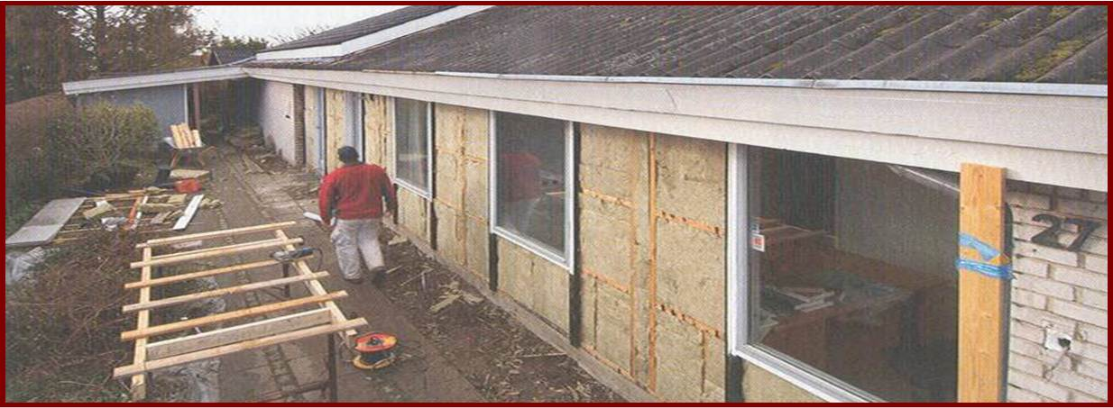
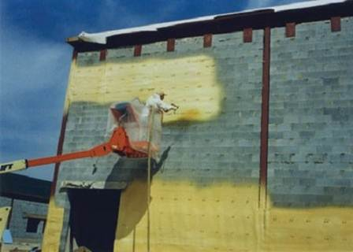
Various Application Methods
External Wall Insulation with
Rockwool slabs
PU External Roof & Wall Spray
Insulation

Slide 17
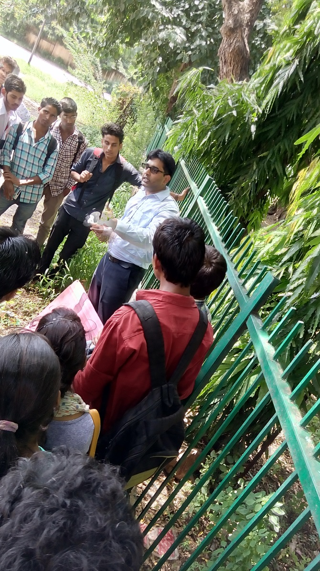
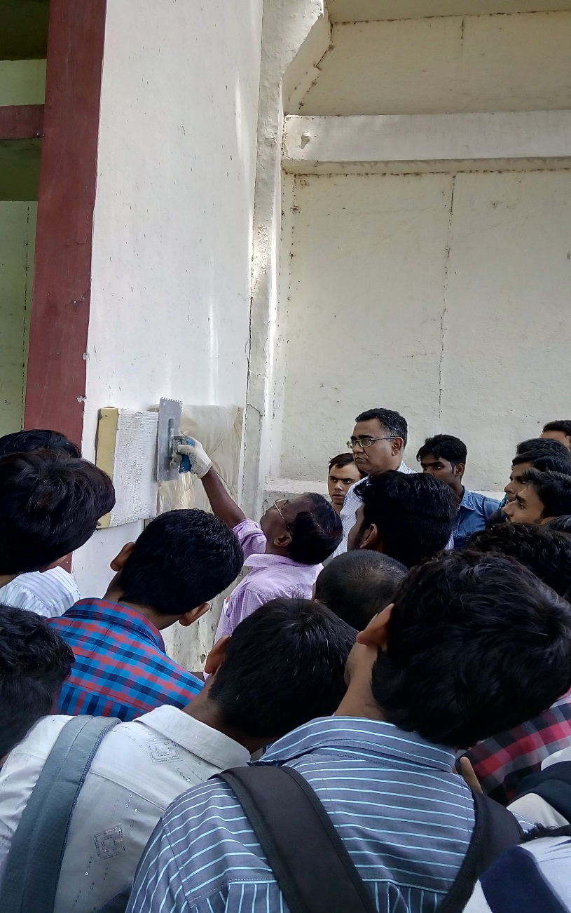
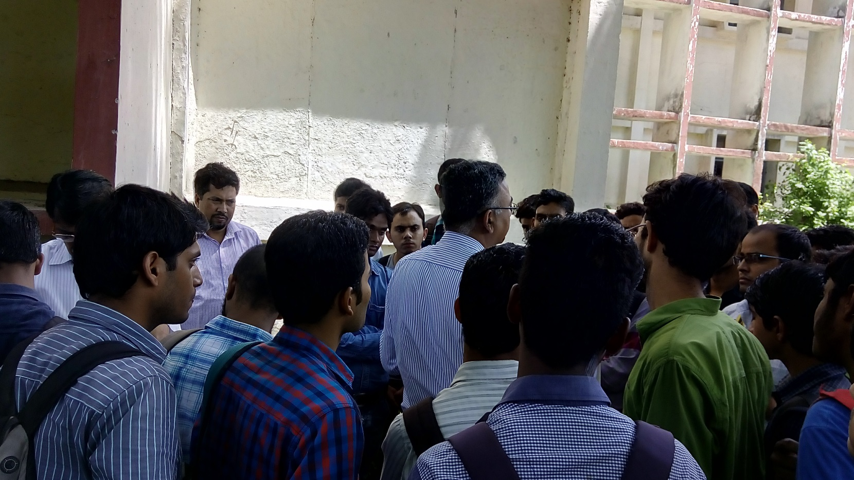
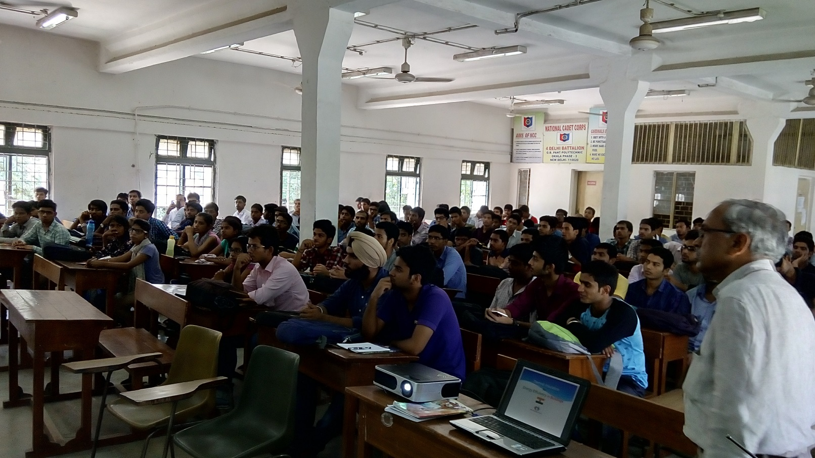
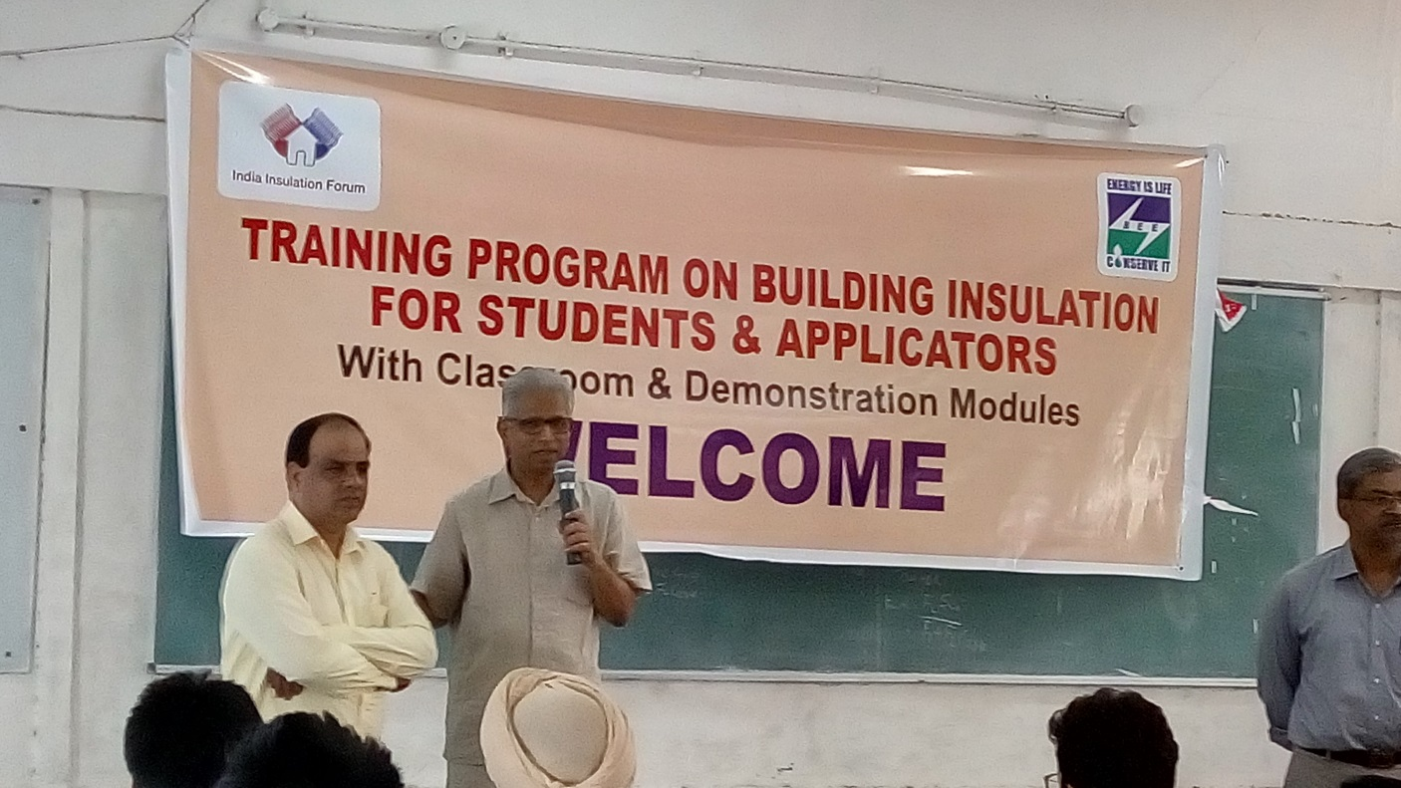
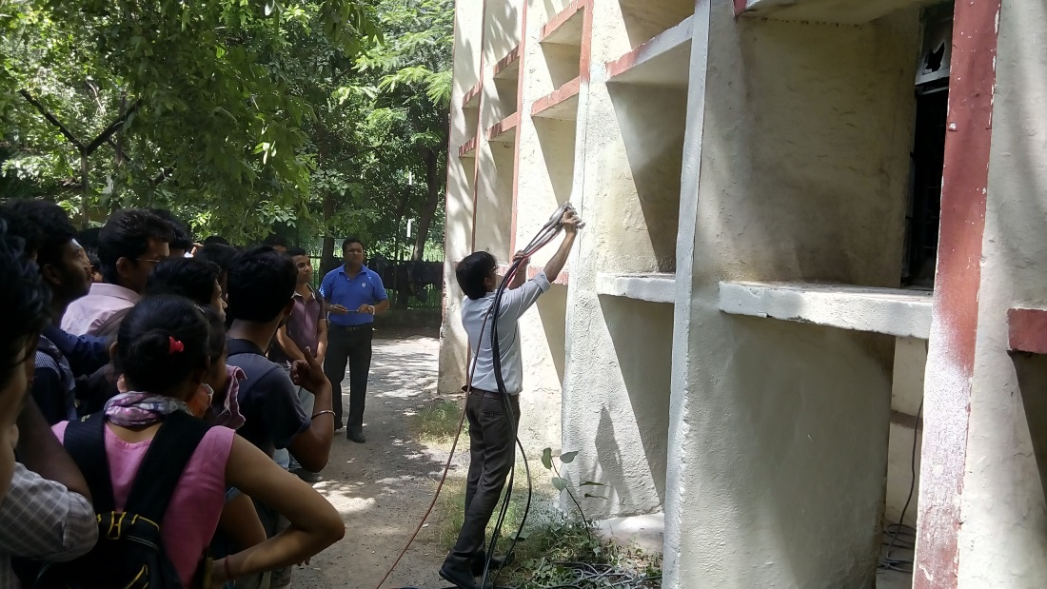
G B Pant Polytechnic

Slide 18
Website
FAQs will be addressed, a mine of resources and tools will be publicly available members can learn on the latest on insulation ideas across the country and globally.
This will also be a platform where technical marketing space will be available for those concerned in the value chain can reach out.
www.indiainsulationforum.inIndia Insulation Forum

Slide 19
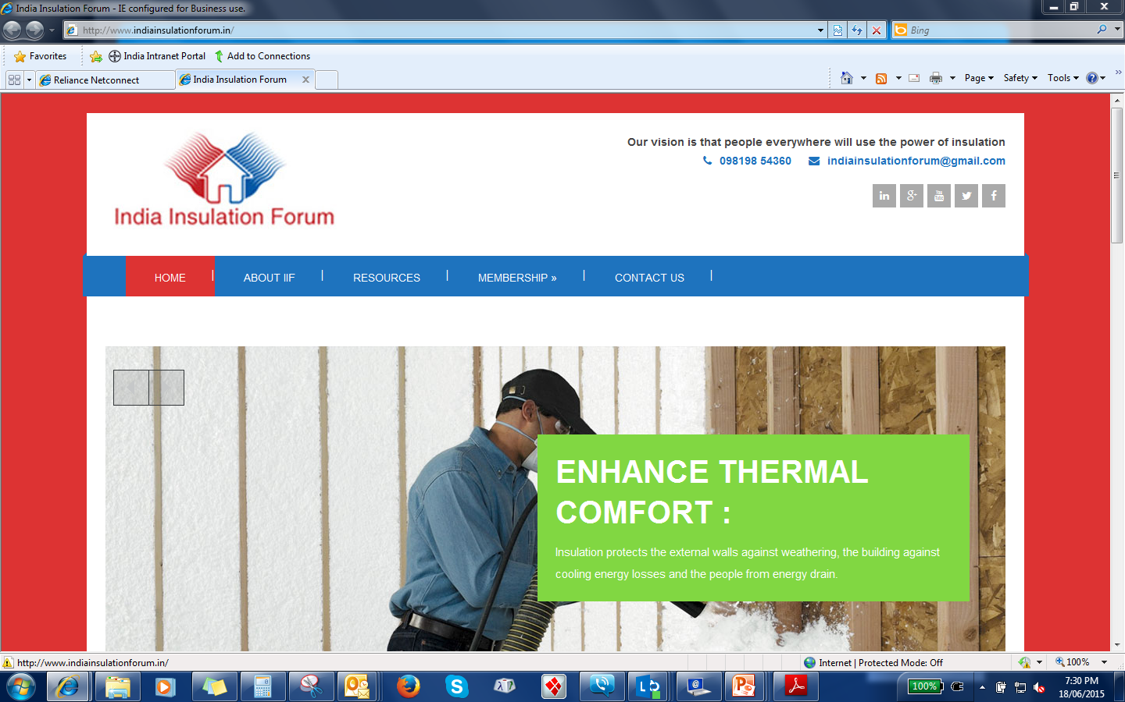

Slide 20
Agenda
What is IIF?
What has IIF done so far?
What does IIF plan to do?

Slide 21
Way Forward
Awareness Seminars
Energy Code Training
Insulation Materials Testing Facility Program
Applicator / ITI Training Program
Online Tools
Pan India
Not a stone unturned
Social Advocacy
News Updates
Events
  Aranya Bhavan

Slide 22
Partnership with Bureau of Energy Efficiency, Min of Power
Alignment with BEE goals is key objective
Co-hosted seminars/webinars every quarter
Ecosystem for mandatory Thermal insulation as per ECBC (R-value)
Grants for home insulation

Slide 23

We seek everyone’s support!
Social Advocacy
News Updates
Events
  Aranya Bhavan

Slide 24
Come Join Us!
Thank You

